Slide 1
Automating Your
Browser and Desktop Apps
(with Python)
@AlSweigart
InventWithPython.com
bit.ly/automatetalk

Slide 2
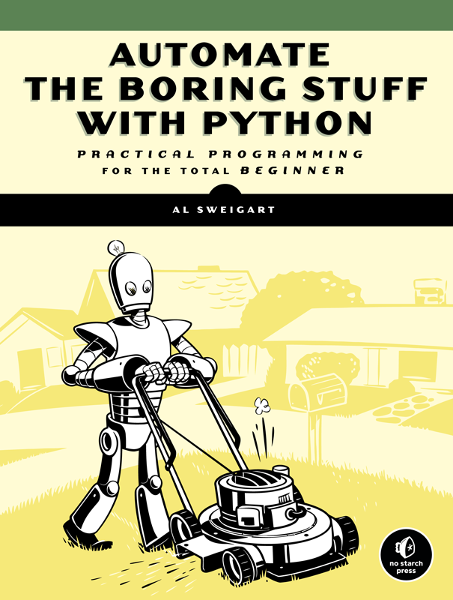
Hi, I’m Al.
I liek programming.
I wrote a programming book.
Creative Commons license.
AutomateTheBoringStuff.com

Slide 3
Web Scraping
DID YOU KNOW?
  The web has interesting stuff on it.
Notes:
The main way we interact is through browsers, but that requires a human and those things are slow and expensive. It’d be much faster to use software to access the web, but then that goes into a lot of things the networking protocols and http and a bunch of other complicated topics, as detailed in this slide…

Slide 4
Not Found
The requested URL was not found on this server.
Additionally, a 404 Not Found error was encountered while trying to use an ErrorDocument to handle the request.

Slide 5
Selenium
pip install selenium
Notes:
>>> from selenium import webdriver
>>> browser = webdriver.Firefox()
>>> browser.get('https://automatetheboringstuff.com')
>>> elem = browser.find_element_by_css_selector('.entry-content > ol:nth-child(15) > li:nth-child(1) > a:nth-child(1)')
>>> elem.click()
>>> menuElem = browser.find_element_by_css_selector('.fa-align-right')
>>> menuElem.click()
>>> searchElem = browser.find_element_by_css_selector('.search-field')
>>> searchElem.send_keys('zophie')
>>> searchElem.submit()
>>> browser.quit()

Slide 6
Selenium
>>> from selenium import webdriver
>>> browser = webdriver.Firefox()
>>> browser.get('https://automatetheboringstuff.com')
>>> elem = browser.find_element_by_css_selector('.entry-content > ol:nth-child(15) > li:nth-child(1) > a:nth-child(1)')
>>> elem.click()
>>> browser.quit()
Notes:
>>> from selenium import webdriver
>>> browser = webdriver.Firefox()
>>> browser.get('https://automatetheboringstuff.com')
>>> elem = browser.find_element_by_css_selector('.entry-content > ol:nth-child(15) > li:nth-child(1) > a:nth-child(1)')
>>> elem.click()
>>> menuElem = browser.find_element_by_css_selector('.fa-align-right')
>>> menuElem.click()
>>> searchElem = browser.find_element_by_css_selector('.search-field')
>>> searchElem.send_keys('zophie')
>>> searchElem.submit()
>>> browser.quit()

Slide 7
Selenium
>>> from selenium import webdriver
>>> browser = webdriver.Firefox()
>>> browser.get('https://automatetheboringstuff.com')
>>> elem = browser.find_element_by_css_selector('.entry-content > ol:nth-child(15) > li:nth-child(1) > a:nth-child(1)')
>>> elem.click()
>>> browser.quit()
Notes:
>>> from selenium import webdriver
>>> browser = webdriver.Firefox()
>>> browser.get('https://automatetheboringstuff.com')
>>> elem = browser.find_element_by_css_selector('.entry-content > ol:nth-child(15) > li:nth-child(1) > a:nth-child(1)')
>>> elem.click()
>>> menuElem = browser.find_element_by_css_selector('.fa-align-right')
>>> menuElem.click()
>>> searchElem = browser.find_element_by_css_selector('.search-field')
>>> searchElem.send_keys('zophie')
>>> searchElem.submit()
>>> browser.quit()

Slide 8
Selenium
>>> from selenium import webdriver
>>> browser = webdriver.Firefox()
>>> browser.get('https://automatetheboringstuff.com')
>>> elem = browser.find_element_by_css_selector('.entry-content > ol:nth-child(15) > li:nth-child(1) > a:nth-child(1)')
>>> elem.click()
>>> browser.quit()
Notes:
>>> from selenium import webdriver
>>> browser = webdriver.Firefox()
>>> browser.get('https://automatetheboringstuff.com')
>>> elem = browser.find_element_by_css_selector('.entry-content > ol:nth-child(15) > li:nth-child(1) > a:nth-child(1)')
>>> elem.click()
>>> menuElem = browser.find_element_by_css_selector('.fa-align-right')
>>> menuElem.click()
>>> searchElem = browser.find_element_by_css_selector('.search-field')
>>> searchElem.send_keys('zophie')
>>> searchElem.submit()
>>> browser.quit()

Slide 9
Selenium
>>> from selenium import webdriver
>>> browser = webdriver.Firefox()
>>> browser.get('https://automatetheboringstuff.com')
>>> elem = browser.find_element_by_css_selector('.entry-content > ol:nth-child(15) > li:nth-child(1) > a:nth-child(1)')
>>> elem.click()
>>> browser.quit()
Notes:
>>> from selenium import webdriver
>>> browser = webdriver.Firefox()
>>> browser.get('https://automatetheboringstuff.com')
>>> elem = browser.find_element_by_css_selector('.entry-content > ol:nth-child(15) > li:nth-child(1) > a:nth-child(1)')
>>> elem.click()
>>> menuElem = browser.find_element_by_css_selector('.fa-align-right')
>>> menuElem.click()
>>> searchElem = browser.find_element_by_css_selector('.search-field')
>>> searchElem.send_keys('zophie')
>>> searchElem.submit()
>>> browser.quit()

Slide 10
Selenium
>>> from selenium import webdriver
>>> browser = webdriver.Firefox()
>>> browser.get('https://automatetheboringstuff.com')
>>> elem = browser.find_element_by_css_selector('.entry-content > ol:nth-child(15) > li:nth-child(1) > a:nth-child(1)')
>>> elem.click()
>>> browser.quit()
Notes:
>>> from selenium import webdriver
>>> browser = webdriver.Firefox()
>>> browser.get('https://automatetheboringstuff.com')
>>> elem = browser.find_element_by_css_selector('.entry-content > ol:nth-child(15) > li:nth-child(1) > a:nth-child(1)')
>>> elem.click()
>>> menuElem = browser.find_element_by_css_selector('.fa-align-right')
>>> menuElem.click()
>>> searchElem = browser.find_element_by_css_selector('.search-field')
>>> searchElem.send_keys('zophie')
>>> searchElem.submit()
>>> browser.quit()

Slide 11
Selenium
>>> from selenium import webdriver
>>> browser = webdriver.Firefox()
>>> browser.get('https://automatetheboringstuff.com')
>>> elem = browser.find_element_by_css_selector('.entry-content > ol:nth-child(15) > li:nth-child(1) > a:nth-child(1)')
>>> elem.click()
>>> browser.quit()
Notes:
>>> from selenium import webdriver
>>> browser = webdriver.Firefox()
>>> browser.get('https://automatetheboringstuff.com')
>>> elem = browser.find_element_by_css_selector('.entry-content > ol:nth-child(15) > li:nth-child(1) > a:nth-child(1)')
>>> elem.click()
>>> menuElem = browser.find_element_by_css_selector('.fa-align-right')
>>> menuElem.click()
>>> searchElem = browser.find_element_by_css_selector('.search-field')
>>> searchElem.send_keys('zophie')
>>> searchElem.submit()
>>> browser.quit()

Slide 12
Selenium
>>> from selenium import webdriver
>>> browser = webdriver.Firefox()
>>> browser.get('https://automatetheboringstuff.com')
>>> elem = browser.find_element_by_css_selector('.entry-content > ol:nth-child(15) > li:nth-child(1) > a:nth-child(1)')
>>> elem.click()
>>> browser.quit()
Notes:
>>> from selenium import webdriver
>>> browser = webdriver.Firefox()
>>> browser.get('https://automatetheboringstuff.com')
>>> elem = browser.find_element_by_css_selector('.entry-content > ol:nth-child(15) > li:nth-child(1) > a:nth-child(1)')
>>> elem.click()
>>> menuElem = browser.find_element_by_css_selector('.fa-align-right')
>>> menuElem.click()
>>> searchElem = browser.find_element_by_css_selector('.search-field')
>>> searchElem.send_keys('zophie')
>>> searchElem.submit()
>>> browser.quit()

Slide 13
CSS Selector Syntax
browser.find_element_by_css_selector('.entry-content > ol:nth-child(15) > li:nth-child(1) > a:nth-child(1)')
Returns an element object.
(Also: find_elements_by_css_selector() which returns a list of element objects.)

Slide 14
Clicking and Typing
Element object methods:
  click()
  send_keys()
  submit()

Slide 15
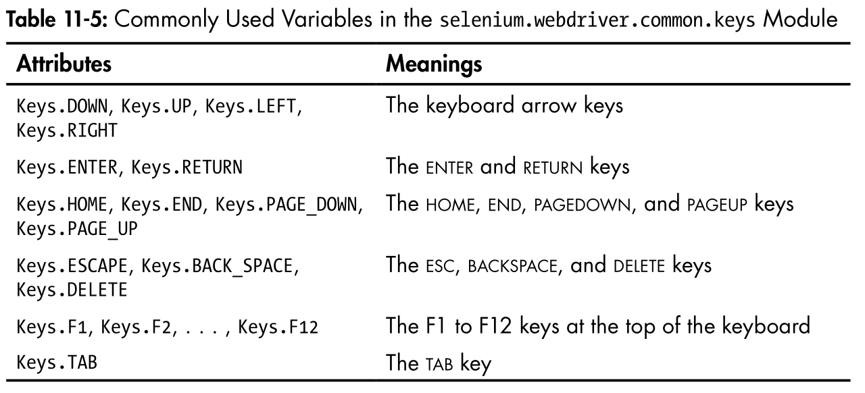
Clicking and Typing
Special key values (up arrow, F1, Ctrl, etc.)

Slide 16
Clicking and Typing
“Flat is better than nested.”
from selenium.webdriver.common.keys import Keys

Slide 17
Misc Browser Stuff
browser.back()
browser.forward()
browser.refresh()

Slide 18
Reading Data from the Web Page
elem.text
elem.get_attribute('href')
To get ALL attributes:
  elem.get_attributes()

Slide 19
Reading Data from the Web Page
elem.text
elem.get_attribute('href')
To get ALL attributes:
  elem.get_attributes()
  elem.get_attribute('outerHTML')
  '<a href="" class="main-navigation-toggle"><i class="fa fa-bars"></i></a>'

Slide 20
GUI Automation
Control the mouse and keyboard.

Slide 21
Installing PyAutoGUI
pip install pyautogui
  Works on Python 2 & 3
  Works on Windows, Mac, & Linux
  Simple API
https://pyautogui.readthedocs.org

Slide 22
Mouse Control
click()
click([x, y])
doubleClick()
rightClick()
moveTo(x, y [, duration=seconds])
moveRel(x_offset, y_offset [, duration=seconds])
dragTo(x, y [, duration=seconds])
position() (returns (x, y) tuple)
size() (returns (width, height) tuple)
displayMousePosition()
Notes:
MSPaint doesn’t have an API. There’s no way to programmatically control it. But you can programmatically control the mouse to create your own art bot. You might think, well, okay, but Al you can use an image library to create images with square spirals in them. Yes, but if you have a fancy art program with fancy brushes, you get to make use of those. And by fancy art program, I guess I mean MSPaint.

Slide 23
Keyboard Control
typewrite('Text goes here.' [, interval=secs])
press('pageup')
pyautogui.KEYBOARD_KEYS
hotkey('ctrl', 'o')

Slide 24
Spiral Drawing Live Demo
TEMPT THE GODS ONCE MORE.

Slide 25

WARNING
Notes:
I’m going to live demo the GUI automation laptop

Slide 26
Failsafe
Move the mouse to the top-left corner of the screen to raise the FailSafeException.
pyautogui.PAUSE is set to 0.1, adding a tenth-second delay after each call.

Slide 27
Image Recognition
Linux: sudo apt-get scrot
pixel(x, y)
  returns RGB tuple
screenshot([filename])
  returns PIL/Pillow Image object [and saves to file]
locateOnScreen(imageFilename)
  returns (left, top, width, height) tuple or None

Slide 28
What is GUI automation used for?
Automating tests for non-browser apps.
Automating non-HTML parts of browser apps.
Cheating at Flash games.

Slide 29
THE GOAL: Cheating at Flash Games
LIVE DEMO, BABY

Slide 30
Thanks!
bit.ly/automatetalk
pip install selenium
pip install pyautogui
AutomateTheBoringStuff.com
@AlSweigart
al@inventwithpython.com

